Slide 1
Quality Catch Overview
Dec 2021

Slide 2




Preventative Tools in Motion
Driving Preventative Quality Culture in our Manufacturing & Distribution Workstations
Analogy
Build
Ensure workstations are born low risk by identifying key vulnerabilities in our Mfg. and DC processes
Monitor/Control
Drive Quality at the source by identifying and prioritizing quality issues before they reach the patient
Improve
Identify, manage, and implement improvements using problem and/or process improvement methodologies as needed
Repair
Confirmed non-conformance; investigate and make corrections (NCEP) or reduce or eliminate the problem occurrence (CAPA)
WSVA, CI, Quality Catch, PCAPA
WSVA
Quality Catch
eCAPA
Tools

Slide 3
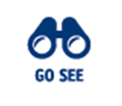
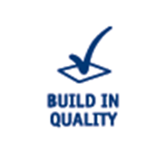
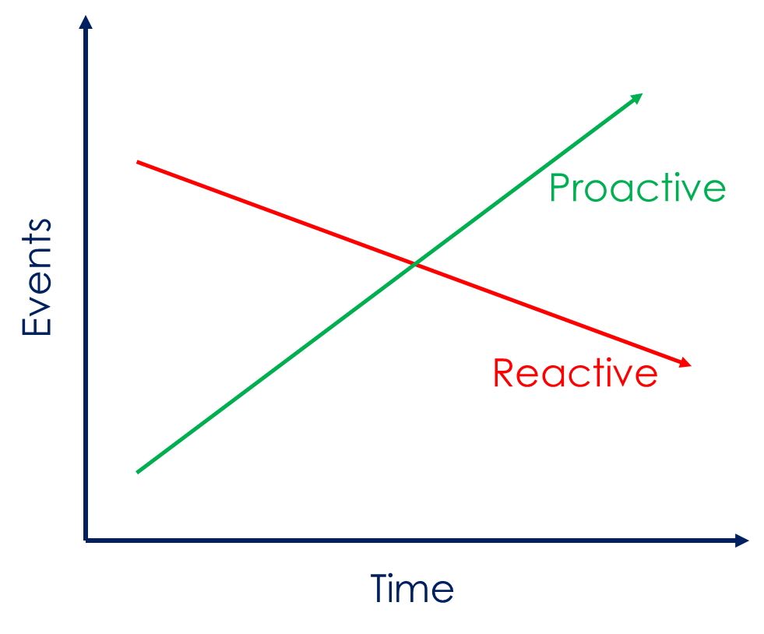

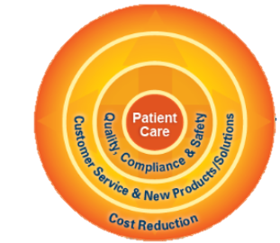

Quality Catch Program
Purpose: Identify, prioritize, and resolve quality issues within the Production Environment before they reach the patient
  Continued focus on Quality at the Source
Revamp of QI Program to include both reactive and proactive events/signal sources
Events logged in centralized database and scored to help determine significance & priority
  Purpose
  Patient Centric Culture
  ↓ Reactive; ↑ Proactive

Slide 4
Program Benefits
Reinvigorate efforts to drive Quality at the Source
Incentivize organization to identify proactive opportunities
Allow Sites to focus on high priority risks/vulnerabilities
  Use of simple scoring method linked to patient risk to facilitate escalation
Centralized database to facilitate identification of opportunities and prioritization of improvement
  Currently no easy way to enter, find, or trend Quality data across the Site
  Hard to determine where to focus efforts
  Allow for mitigation tracking to ensure open items are closed
  Database will help facilitate adoption of centralized metrics to measure progress and performance
Quality Incident (QI)
Quality Star /Eagle Eye
Quality Catch App
Process Errors
Line GEMBA

Slide 5
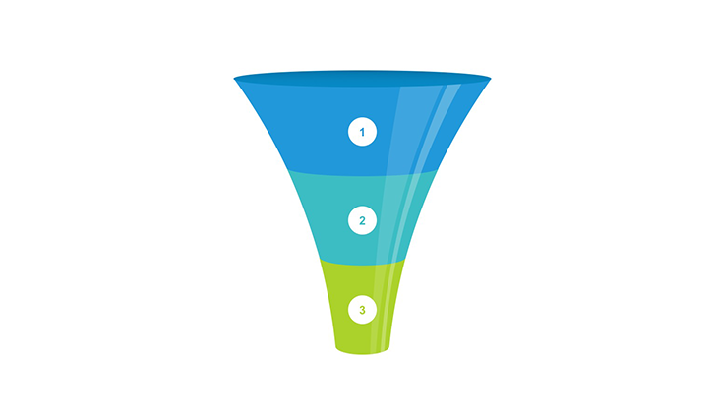
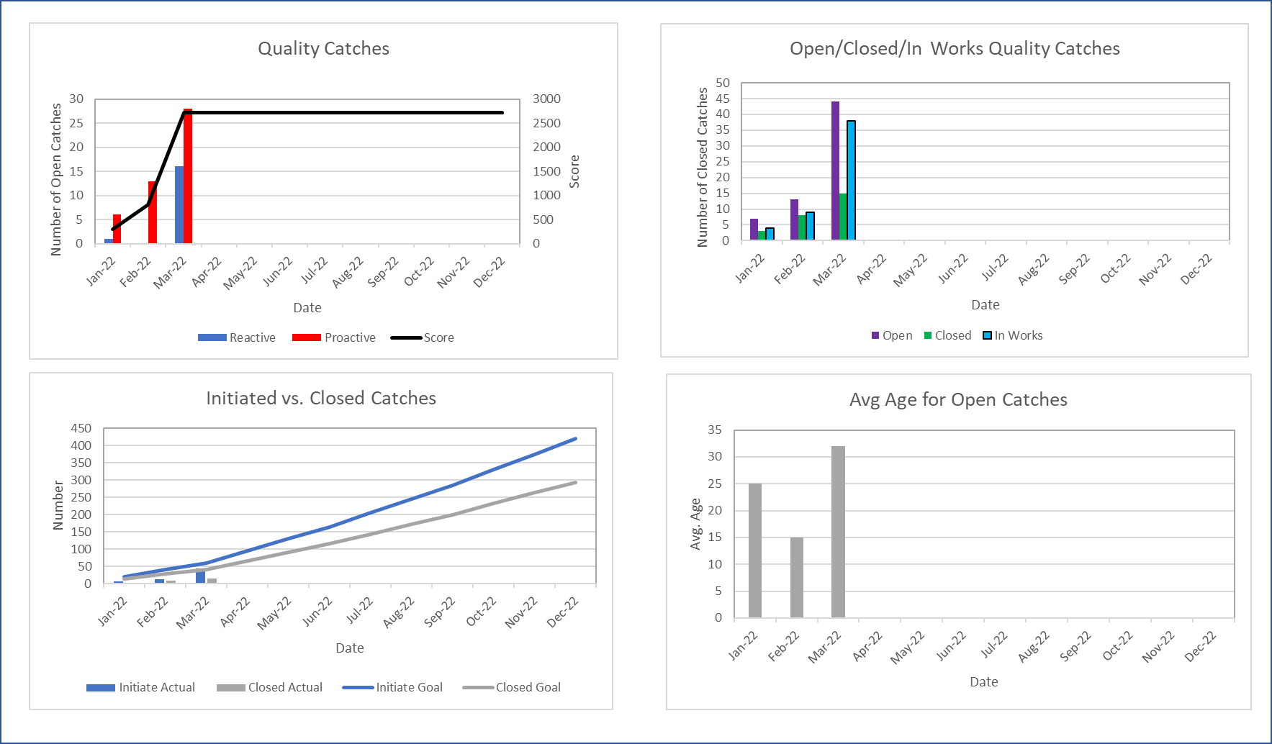
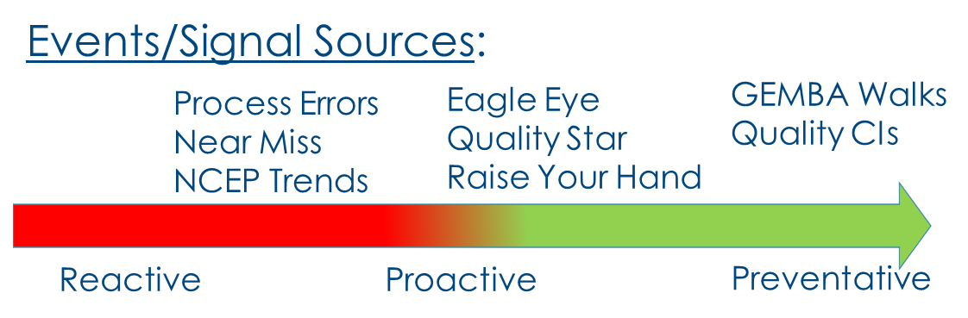
High Level Process
Establish Improvement Plan
% Catches Opened
% Catches Closed
Signal Sources
Scored to quantify significance/priority
Impact to Patient
Measure Progress to Plan
High Priority Catches

Slide 6
Key Roles
Role | Responsibility
Production Unit (PU) | Own and are accountable for Core 6/PU Quality Catch performance Develop Quality Catch Improvement Plan Drive creation, review, investigation, and resolution of all relevant signals/events
Champions (Best Practice - all 3 functions) | Provide subject matter expertise on process Work with Production Units to ensure Product Builder engagement and success Ensure any Quality CIs that are transferred over from GCIBS are appropriately characterized and assigned an owner Voice of customer to drive continuous improvement
Champion Recommendations (minimum):
Production – Production Supervisor as they are closest to direct labor staff
Quality – floor support engineer or technician
All Functions (ME, QE, Production) Critical to Ensuring Success!

Slide 7
Quality Catch vs. CI vs. eCAPA
Quality Catch ≠ CI ≠ eCAPA
No automatic non-conformances in Quality Catch
  One exception – those deemed a QI will be populated in Quality Catch for scoring purposes
CIs will continue to be populated in the Global CI tool (GCIBS)
  Those deemed “Quality Catches” will be pushed to the Quality Catch database by the GCIBS admin and locked for further editing in GCIBS
  CIs in scope – those deemed product-impacting that should be prioritized with all other relevant signal sources in Quality Catch
  Target completion of database enhancements & roll-out – end of January 2022

Slide 8
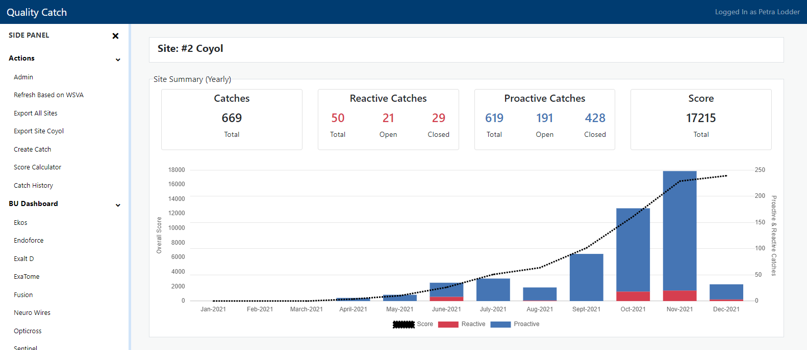
Application Overview
Link: https://quality-catch.internal.prod.apps.bsci.com
Accessible to all BSC network users via their network ID and password
Home Page provides high level visualization of reactive and proactive catches by month along with listing of individual catches and mitigations
Click Here

Slide 9
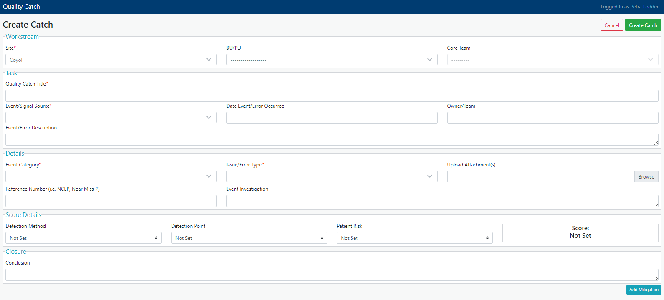
Creating a Catch
Entry of catch is simple with minimal required fields
Smart form capability built-in depending on selected Signal Source
Can always edit the record to add additional details
  Example: score details populated at later stage by appropriate QE/ME
Score calculator for potential significance of signal
Mitigations can be created and managed within the application

Slide 10
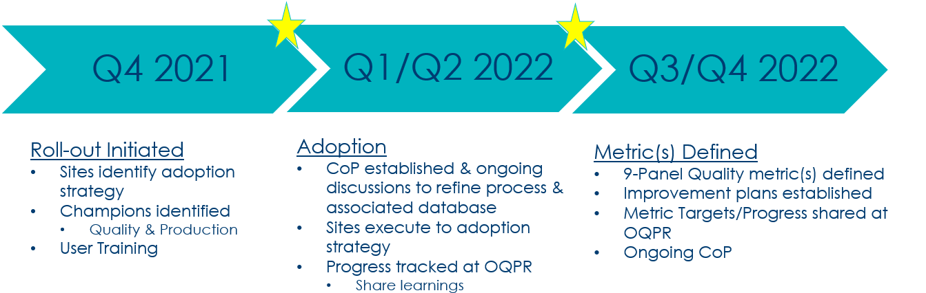
Measuring Performance
Purpose: Provide reliable signal of quality health and measure of overall performance to plan
Proposed Metrics:
  # of Catches Open
  # of Catches Closed
Use real time feedback as sites adopt to solidify the right metric(s) to incorporate within the 2023 9-Panel
Adoption Strategy:

